Slide 1

North Tonawanda Charter Committee
Mayor Austin Tylec
Chair: Lou DalPorto Vice-Chair: David Burgio Secretary: Karl Bauer
Members: Darlene Bolsover, Danial Brick, Vincent Ginestre, Ellen Hutton, Penny Kirst, Chet Klimek, John Snopkowski, Susan Taylor, Kate Wistner, Donald Wittcop

Slide 2
Who We Are
WE THE CHARTER COMMITTEE CAME TOGETHER UNDER THE APPOINTMENT OF MAYOR AUSTIN TYLEC IN 2022.
WE ARE A NON-PARTISAN GROUP OF DEMOCRATS, REPUBLICANS, WORKING FAMILIES, AND NON-PARTY AFFILIATIONS. MANY OF US SERVED ON PRIOR ADMINISTRATION’S CHARTER COMMITTEES.
AS VOLUNTEERS, WE WORKED TO RECOMMEND REFINEMENTS OF THE CITY CHARTER TO BEST REPRESENT THE RESIDENTS OF NORTH TONAWANDA.
THE RECOMMENDATIONS WERE FILED WITH THE BOARD OF ELECTIONS, GIVING RESIDENTS THE POWER TO VOTE YES OR NO ON NOVEMBER 7, 2023.

Slide 3
What A Charter Committee Can Do
Alter a form of government so it is better aligned with the preference of the citizens
Increase options available to government leaders
Clarify ambiguity or confusion caused by existing charter language
Redistribute powers among elected and appointed officials and governing bodies, as well as between city officials and citizens
Set the stage for government leaders to achieve desired changes
Convert elected governmental positions to appointed positions or vice versa

Slide 4
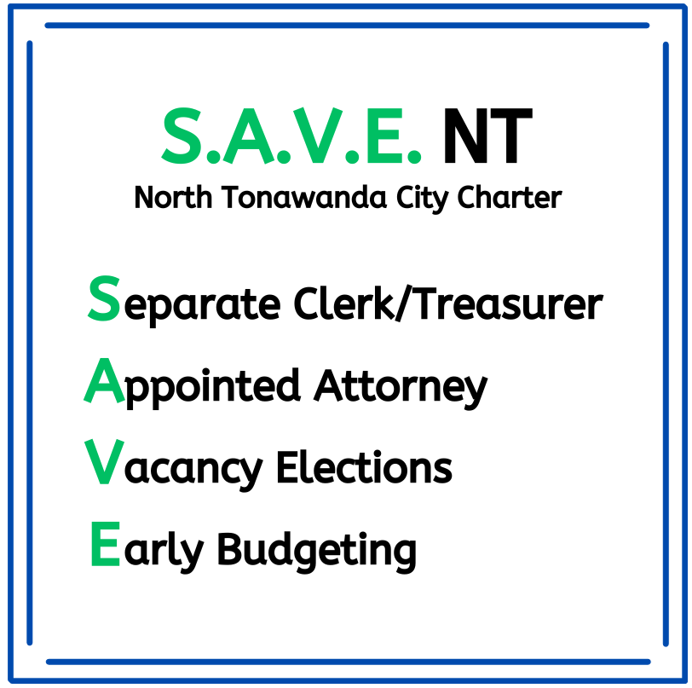
YOU HAVE THE POWER TO CHANGE NT’S FUTURE FOR THE BETTER!

Slide 5

Separate Clerk/Treasurer
SHALL THE POSITION OF THE CITY CLERK-TREASURER BE SEPARATED INTO TWO POSITIONS, WITH THE CITY CLERK ELECTED, AND THE TREASURER APPOINTED BY THE MAYOR FOLLOWING CONSULTATION WITH THE COMMON COUNCIL?
Better Professional Management of Tax Dollars
Two Separate Skill Sets
First Combined in 2008 in an Effort to Save the City Money – It Did Not Work
Treasurer Will Have Civil Service Qualifications
Will Not Add Cost To Tax Payers

Slide 6

Appointed Attorney
SHALL THE CITY ATTORNEY BE APPOINTED BY THE MAYOR FOLLOWING CONSULTATION WITH THE COMMON COUNCIL?
Only 2 Cities in the Entire State of New York Have Elected City Attorneys. All Others Have Appointed Counsel To Avoid Conflicts of Interest
Recommended by Previous City Attorney
City of Tonawanda Changed to an Appointed Attorney
This Photo by Unknown author is licensed under CC BY-SA.

Slide 7

Vacancy Elections
SHALL THE VACANCIES OF AN ELECTED OFFICIAL WHOSE TERM HAS SIX (6) MONTHS OR GREATER BE FILLED BY SPECIAL ELECTIONS, WITH VACANCIES OF ELECTED OFFICIALS HAVING FEWER THAN 6 MONTHS REMAINING STAY VACANT UNTIL THE NEXT REGULARLY SCHEDULED ELECTION?
Allocates Power to the People
In the Last 20 Years,16 Vacated Elected Positions Have Been Appointed By the Council, Rather than Elected by the Voters

Slide 8

Early Budgeting
SHALL CITY BUDGETARY DEADLINES REVERT TO THE CITY CHARTER OF 1998?
Proposed City Budget Submission Deadline Will Revert Back To August 1, from the Current Date of October 1
Budget BEFORE Election
Gives YOU, The Resident The Financial Information You Need
Better Planning For The Residents And The City

Slide 9


Flip The Ballot!

Slide 10
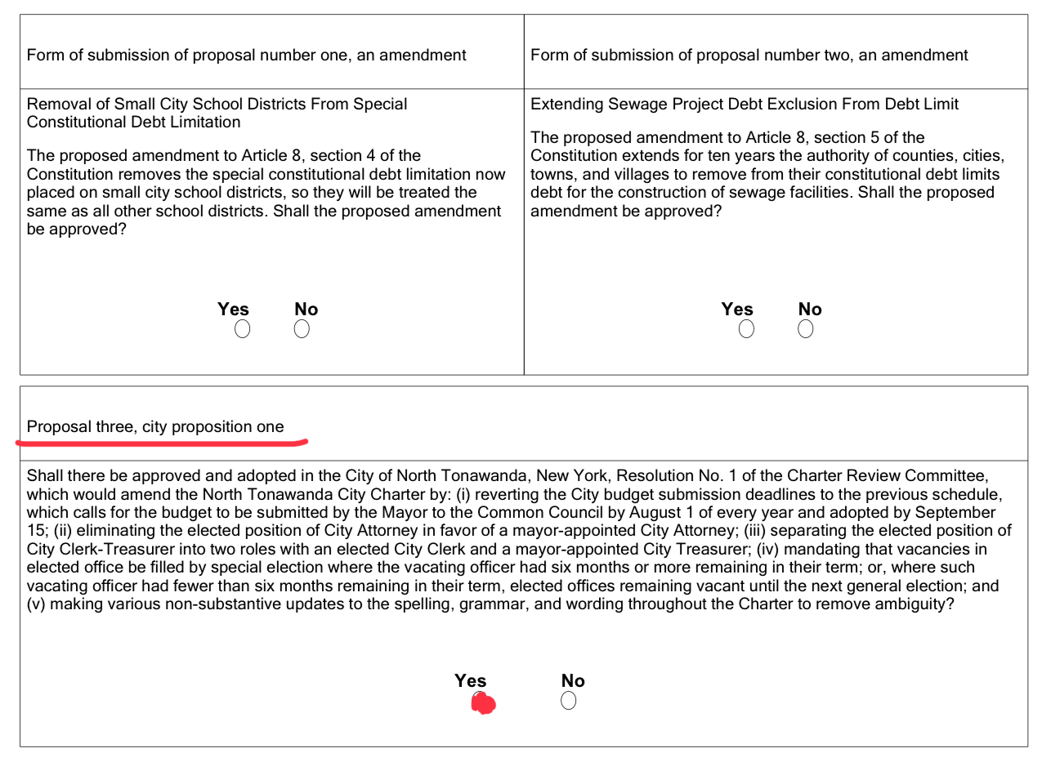
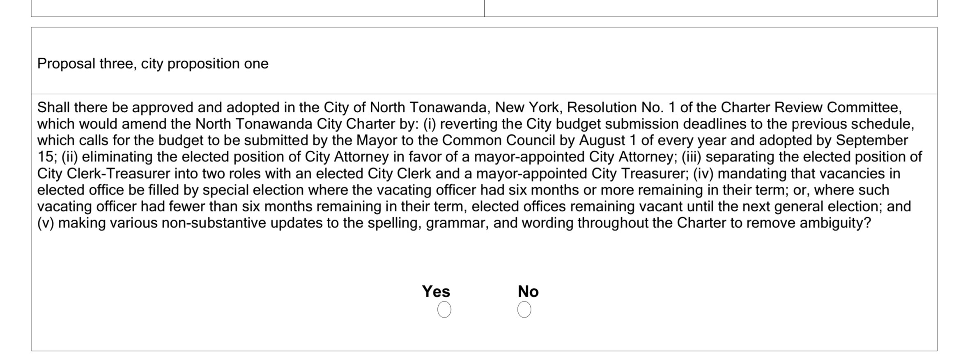
FLIP THE BALLOT
VOTE YES!!

